Slide 1
2025 Second Quarter Market Outlook
Steering Through Uncertainty
--Rep Name
--Firm-Approved Title
--Registered Branch Address
--Approved Email and/or Registered Phone
--Securities Disclosure
Enter all information and submit to Ad Review for final approval
Notes:
Intro

Slide 2
Primary Themes of Second Quarter
1
Lack of Confidence
2
Perspective Matters
3
Diversification is Rewarded
Notes:
Three Themes

Slide 3
Lack Of Confidence
Notes:
First Theme

Slide 4
Questioning AI Spending
Notes:
In mid-January a group of large tech companies pledged to spend up to $500 billion in AI infrastructure.
A week later, DeepSeek, emerged, jeopardizing the growth prospects for future spending, which could potentially impact chipmakers and others who have benefited from this large spending spree.
DeepSeek’s models were also open source and free, casting doubt on U.S. companies’ business models which looked to generate revenues from charging fees.

Slide 5
Uncertainty Around Tariffs
Notes:
Driving the growth and inflation concerns were the news around tariffs. Although unlikely, the effective U.S. tariff rate would rise from 2.5% to 9.5%, the highest since the 1940s, if 20-25% tariffs on imported goods from China, Mexico, and Canada are fully implemented, according to Yale Budget Lab analysis.

Slide 6
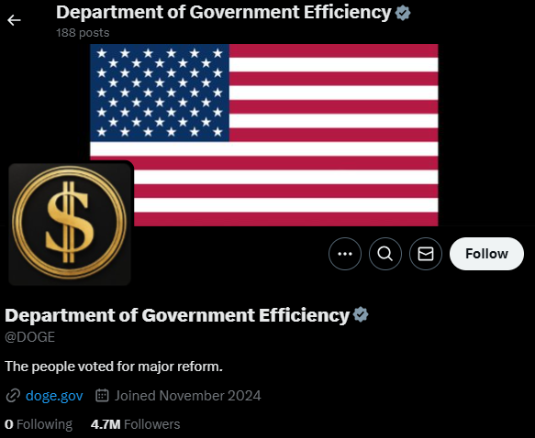
Government Spending
Notes:
Two worries in the first quarter were related to government spending.
A government shutdown was avoided with a stopgap spending bill which expires 9/30.
Causing more near-term uncertainty regarding government spending is the administration’s Department of Government Efficiency or DOGE. DOGE is looking to cut federal spending and payrolls which will ultimately add to unemployment and reduced government spending. The impact this has on the economy will revolve around the magnitude of the cuts.

Slide 7
Job Cuts
Notes:
Looking to the labor market, Challenger, Gray & Christmas reported job cut announcements spiked the most since July 2020 in February.

Slide 8
Economic Growth Concerns
Notes:
Looking to manufacturing the most forward looking component of a leading manufacturing survey, New Orders, plummet in February.

Slide 9
Consumer Sentiment
Notes:
Both the University of Michigan’s Consumer Sentiment and the Conference Board’s Consumer Confidence have come in much weaker than expected raising concerns about consumer health.

Slide 10
Stock Market Correction (10% Decline)
Notes:
With all this uncertainty the S&P 500 went into correction for the first time since October 2023.

Slide 11
Perspective Matters
Notes:
Enough with the bad news. Let’s talk about reasons to be optimistic.

Slide 12
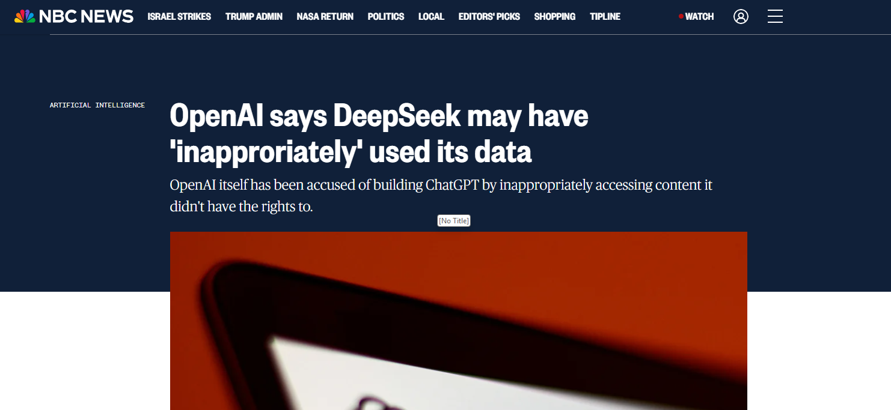
Questions Around DeepSeek
Notes:
Τηερε αρε στιλλ μανψ θυεστιονσ ρεγαρδινγ ΔεεπΣεεκ. Αμεριχαν οωνεδ χομπανψ, ΟπενΑΙ, ηασ αχχυσεδ τηε χομπανψ οφ σεχρετλψ υσινγ δατα προδυχεδ βψ ΟπενΑΙ’σ τεχηνολογψ. Τηερε αρε αλσο θυεστιονσ συρρουνδινγ ηοω μανψ χηιπσ τηε χομπανψ υσεσ ανδ περηαπσ τηε εφφιχιενχιεσ αρεν’τ ασ μυχη ασ οριγιναλλψ χλαιμεδ.

Slide 13
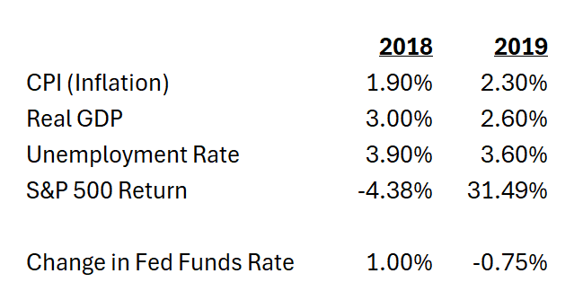
Tariffs Aren’t New Anymore
Source: FactSet, Cetera Investment Management.
Notes:
Ταριφφσ ωιλλ βε νεγοτιατεδ, ανδ εϖεντυαλλψ ωε ωιλλ γετ χερταιντψ. Ταριφφσ μαψ αλσο ενδ υπ βεινγ λιμιτεδ το ρεχιπροχαλ. Ταριφφσ αρε αλσο νοτ νεω. Ιν 2018−2019 ωε σαω τηε Υ.Σ. ιμποσε ταριφφσ ον γοοδσ ανδ τηε εχονομψ ηελδ υπ. Τηε ιντερεστ ρατε πολιχψ ωασ διφφερεντ τοο. Τηε Φεδ ωασ ραισινγ ρατεσ ιν 2018!

Slide 14
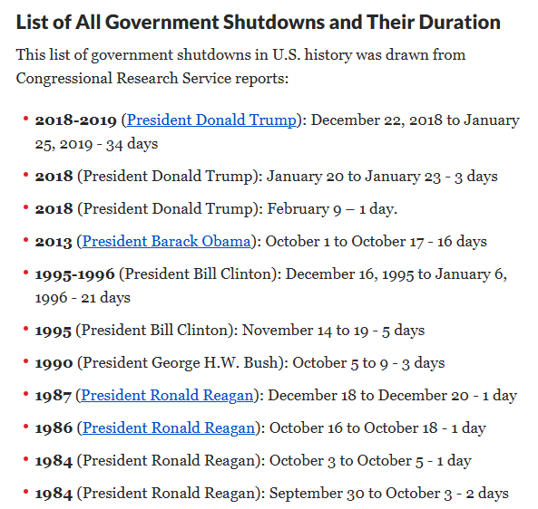
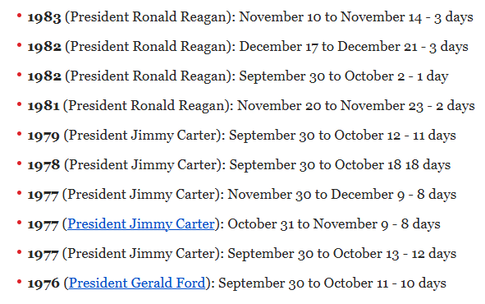
Neither are Government Shutdowns
Notes:
Γοϖερνμεντ σηυτδοωνσ ηιστοριχαλλψ ηαϖε ηαδ λιττλε εχονομιχ ιμπαχτ ασ τηε ιμπαχτ ιτ ηασ ισ υσυαλλψ ϕυστ τρανσφερρεδ φρομ ονε θυαρτερ το ανοτηερ. Ωηιλε τηε υνεμπλοψμεντ ρατε ισν’τ εξπεχτεδ το χλιμβ ϖερψ μυχη φρομ τηε ΔΟΓΕ ϕοβ χυτσ, τηε σπενδινγ χυτσ χουλδ βε α δραγ ον εχονομιχ γροωτη υνλεσσ τηε μονεψ ισ πυτ βαχκ ιντο τηε εχονομψ τηρουγη α ΔΟΓΕ διϖιδενδ ορ οτηερ ινχρεασεσ ιν σπενδινγ ορ ταξ χυτσ. Τηε νετ ιμπαχτ ισ ιμπορταντ, ανδ τηε δεφιχιτ ισ υνλικελψ το βε ρεδυχεδ σιγνιφιχαντλψ (ρεδυχινγ τηε δεφιχιτ ωουλδ ηυρτ ΓΔΠ γροωτη).

Slide 15
Labor Demand
Notes:
Ινφλατιον δατα χοολεδ αφτερ ϑανυαρψ ανδ τηε Βυρεαυ οφ Λαβορ Στατιστιχσ σηοωεδ ϕοβλεσσ χλαιμσ τηατ ωερε σλιγητλψ λοωερ ανδ ϕοβ οπενινγσ ον τηε ρισε ασ σεεν ηερε. ϑοβ οπενινγσ ρεμαιν αβοϖε πρε−πανδεμιχ λεϖελσ. Ιφ τηε λαβορ μαρκετ δοεσ ρολλ οϖερ, τηε Φεδ ισ λικελψ το αχχελερατε τηειρ ρατε χυτ τιμελινε.

Slide 16
January Effect & Cold Weather
Notes:
Α ρεχεσσιον, ωηιλε α χονχερν, δοεσ νοτ σεεμ ιν τηε χαρδσ ασ μυχη οφ ϑανυαρψ’σ εχονομιχ δατα ωασ ηυρτ βψ χολδ ωεατηερ ανδ τηε λαβορ μαρκετ ισ σλοωινγ βυτ νοτ ιμπλοδινγ.

Slide 17
Inflation
Notes:
Inflation Seems to Be Under Control – January was anomaly. And yes, egg prices will fall.

Slide 18
High Yield Investors Aren’t Worried
Notes:
High Yield investors don’t appear worried. They are not demanding more yield for the risk they are taking. During recessions defaults increase and investors will demand more yield.

Slide 19
You Can’t Always Get What You Want
Notes:
The Fed is also watching the labor market. It is dealing with uncertainty of its own. It is trying to balance four factors: fiscal policy, tariffs, deregulation and immigration. The good news is that the Fed can afford to be cautious if the labor market holds up. If the labor market shows signs of deterioration, the Fed will likely move up its timeline to cut interest rates and boost the economy. To quote the Rolling Stones, you can’t always get what you want, but you get what you need. While the Fed has paused rate cuts, they will step in when needed.

Slide 20
Bears Come Out of Hibernation
Notes:
After high levels of optimism in stock markets, the uncertainties finally pulled the bears out of hibernation. Looking at the American Association of Individual Investors Sentiment Survey bearishness is currently at high levels as seen here. This can generally be seen as a contrarian indicator. When everyone is bearish it can mean that the sentiment will change soon and become bullish and could provide upward support for stocks. This could be seen as a behavioral finance topic. People overestimate how good or bad things are going to get. It explains why people are underwhelmed after achieving a good outcome and relieved after a bad outcome occurs. It usually isn’t as good or bad as one anticipated. Yes, there is a lot of uncertainty in the economy right now, but as we discussed there are still reasons to be optimistic. This bearish survey could be another example of a reason to be optimistic.

Slide 21
Diversification is Rewarded
Notes:
So far diversification is finally being rewarded this year as we predicted in our 2025 outlook.

Slide 22
International Stocks
Notes:
Currently, developed international and emerging markets are widely outperforming the S&P 500. Impacts from tariffs on foreign countries remain a question mark for them as well, but some are taking steps to combat the potential impacts. Germany, who has traditionally been stricter with fiscal policy, looks to be planning a historic fiscal stimulus plan. They are planning to allow for higher defense spending and removing a balanced budget restriction for state governments.
Recent Chinese stimulus has been geared toward reducing local government debt which doesn’t have as much of an impact on consumer spending, but that could change soon. The Chinese communist party is now looking to boost consumption considering U.S. tariffs. Plans include raising wages, childcare subsidies, which they also hope encourages more children.
The U.S. is also lucky in that it can be energy independent with an abundance of natural gas and oil. Much of the rest of the world relies on other countries for energy. A ceasefire with Russia and Ukraine could potentially lower energy prices for Europe and China.

Slide 23
Value Stocks
Notes:
Value stocks are also outperforming growth stocks to begin the eyar.

Slide 24
S&P 500 Annual Total Return and Max Drawdown

Slide 25
Thank You!
Follow:@ceteraIM
Notes:
Thank You

Slide 26
Disclosures
About Cetera® Investment Management
Cetera Investment Management LLC is an SEC registered investment adviser owned by Cetera Financial Group®. Cetera Investment Management provides market perspectives, portfolio guidance, model management, and other investment advice to its affiliated broker-dealers, dually registered broker-dealers and registered investment advisers.
About Cetera® Financial Group
“Cetera Financial Group” refers to the network of independent retail firms encompassing, among others, Cetera Advisors LLC, Cetera Advisor Networks LLC, Cetera Investment Services LLC (marketed as Cetera Financial Institutions or Cetera Investors), and Cetera Financial Specialists LLC. All firms are members FINRA/SIPC. Located at 655 W. Broadway, 11th Floor, San Diego, CA 92101.
About Avantax
Avantax, Inc. (Avantax) is a wholly owned subsidiary of Aretec Group, Inc. (dba Cetera Holdings). Avantax is a unique community within Cetera Holdings, delivering tax-intelligent wealth management solutions for financial professionals, tax professionals, and CPA firms.
Avantax operates two distinct, but related, models within its business: the independent Financial Professional model and the employee-based model. The independent Financial Professional model, known as Avantax Wealth Management®, works with a nationwide network of Financial Professionals operating as independent contractors. Avantax Wealth Management offers its services through its registered broker-dealer, Avantax Investment Services, Inc., Member FINRA/SIPC, registered investment advisor (RIA), Avantax Advisory Services, Inc., and insurance agency subsidiaries.
The employee-based model, known as Avantax Planning Partners℠, offers services through its RIA, insurance agency, and affiliated broker-dealer, Avantax Investment Services, Inc. Avantax Planning Partners collaborates with CPA firms to provide their consumer and small-business clients with holistic financial planning and advisory services.
Avantax Investment Services, Inc. is located at 3200 Olympus Blvd, Suite 100, Dallas, TX, 75019. Avantax and Cetera Financial Group are under common ownership. For additional information, please visit www.avantax.com.
Individuals affiliated with Cetera firms are either Registered Representatives who offer only brokerage services and receive transaction-based compensation (commissions), Investment Adviser Representatives who offer only investment advisory services and receive fees based on assets, or both Registered Representatives and Investment Adviser Representatives, who can offer both types of services.
For more information about Cetera Investment Management, please reference the Cetera Investment Management LLC Form ADV disclosure brochure and the disclosure brochure for the registered investment adviser your adviser is registered with. Please consult with your adviser for his or her specific firm registrations and programs available.
No independent analysis has been performed and the material should not be construed as investment advice. Investment decisions should not be based on this material since the information contained here is a singular update, and prudent investment decisions require the analysis of a much broader collection of facts and context. All information is believed to be from reliable sources; however, we make no representation as to its completeness or accuracy. The opinions expressed are as of the date published and may change without notice. Any forward-looking statements are based on assumptions, may not materialize, and are subject to revision.
All economic and performance information is historical and not indicative of future results. The market indices discussed are not actively managed. Investors cannot directly invest in unmanaged indices. Please consult your financial advisor for more information.
Additional risks are associated with international investing, such as currency fluctuations, political and economic instability, and differences in accounting standards.
A diversified portfolio does not assure a profit or protect against loss in a declining market.

Slide 27
Glossary
The S&P 500 is an index of 505 stocks chosen for market size, liquidity and industry grouping (among other factors) designed to be a leading indicator of U.S. equities and is meant to reflect the risk/return characteristics of the large cap universe.
The Russell 1000 Growth Index measures the performance of the large-cap growth segment of the U.S. equity universe. It includes those Russell 1000 Index companies with higher price-to-book ratios and higher forecasted growth values.
The Russell 1000 Value Index measures the performance of the large-cap value segment of the U.S. equity universe. It includes those Russell 1000 Index companies with lower price-to-book ratios and lower forecasted growth values.
The Chicago Board Options Exchange (CBOE) Volatility Index, commonly known by its ticker symbol VIX, is a measure of the stock market's expectation of volatility implied by S&P 500 index options.
The Bloomberg Barclays US Aggregate Bond Index is a broad based flagship benchmark that measures the investment grade, US dollar-denominated, fixed-rate taxable bond market. Eligible bonds must have at least one year until final maturity, but the index holdings have a fluctuating average life of around 8.25 years. This total return index is unhedged and rebalances monthly.
The ICE BofA US High Yield Index tracks the performance of US dollar denominated below investment grade rated corporate debt publicly issued in the U.S. domestic market. To qualify for inclusion in the index, securities must have a below investment grade rating (based on an average of Moody's, S&P, and Fitch) and an investment grade rated country of risk (based on an average of Moody's, S&P, and Fitch foreign currency long term sovereign debt ratings). Each security must have greater than 1 year of remaining maturity, a fixed coupon schedule, and a minimum amount outstanding of $100 million.
The Nasdaq Composite Index is a large, broad-based, market-cap-weighted index of more than 2,500 common equities listed on the Nasdaq stock exchange. It is often seen as a stand-in for the technology sector and its performance.

